Slide 1
CI/CD Project “Make Your Wishes Come TRUE”
Julijan Garbek
Jason Grose
Carlota Moncasi
1/14/2025

Slide 2
Agenda
Project Objectives
Epic & Issue Organization
Task Distribution
Pipeline Framework (Jenkins)
Program Development (Groovy/VSCode)
Deployment
Project Outcome

Slide 3
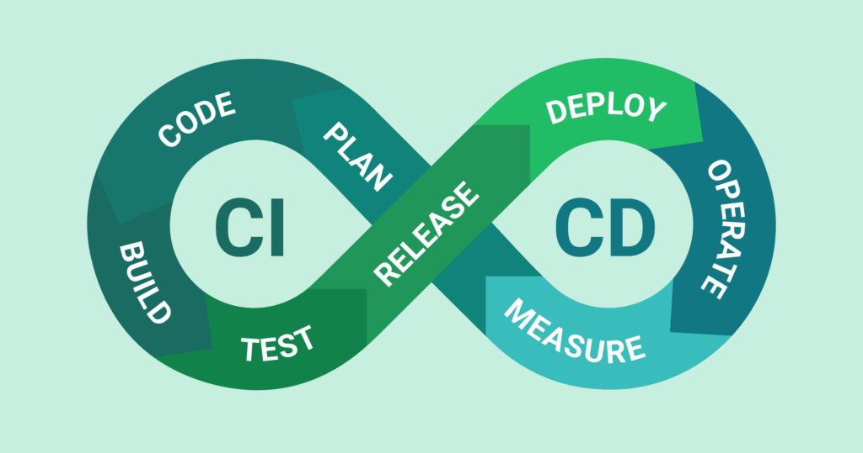
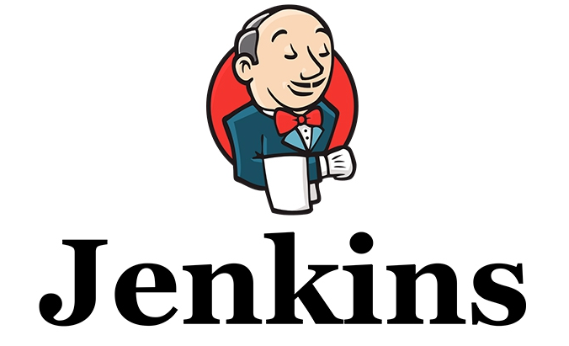
Project Objectives

Slide 4
Where to Start
Our team set the scope of a project following the structure of the proposed ‘January-December’ task-set for “Making your wishes come true”
Arrange these task proposals in Github
Begin constructing the pipeline in VSCode
Verify the pipeline runs in Jenkins
Guarantee the pipeline returns the desired result

Slide 5
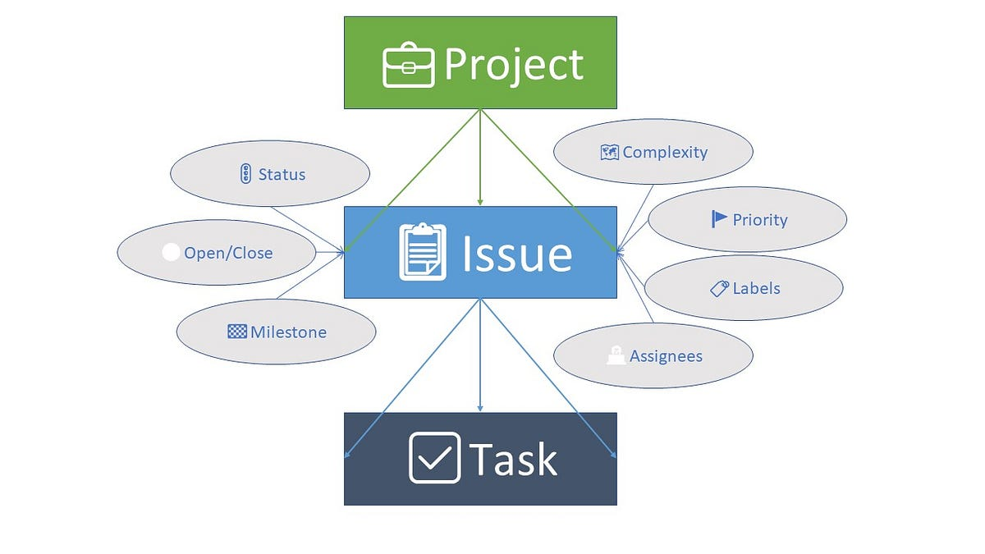
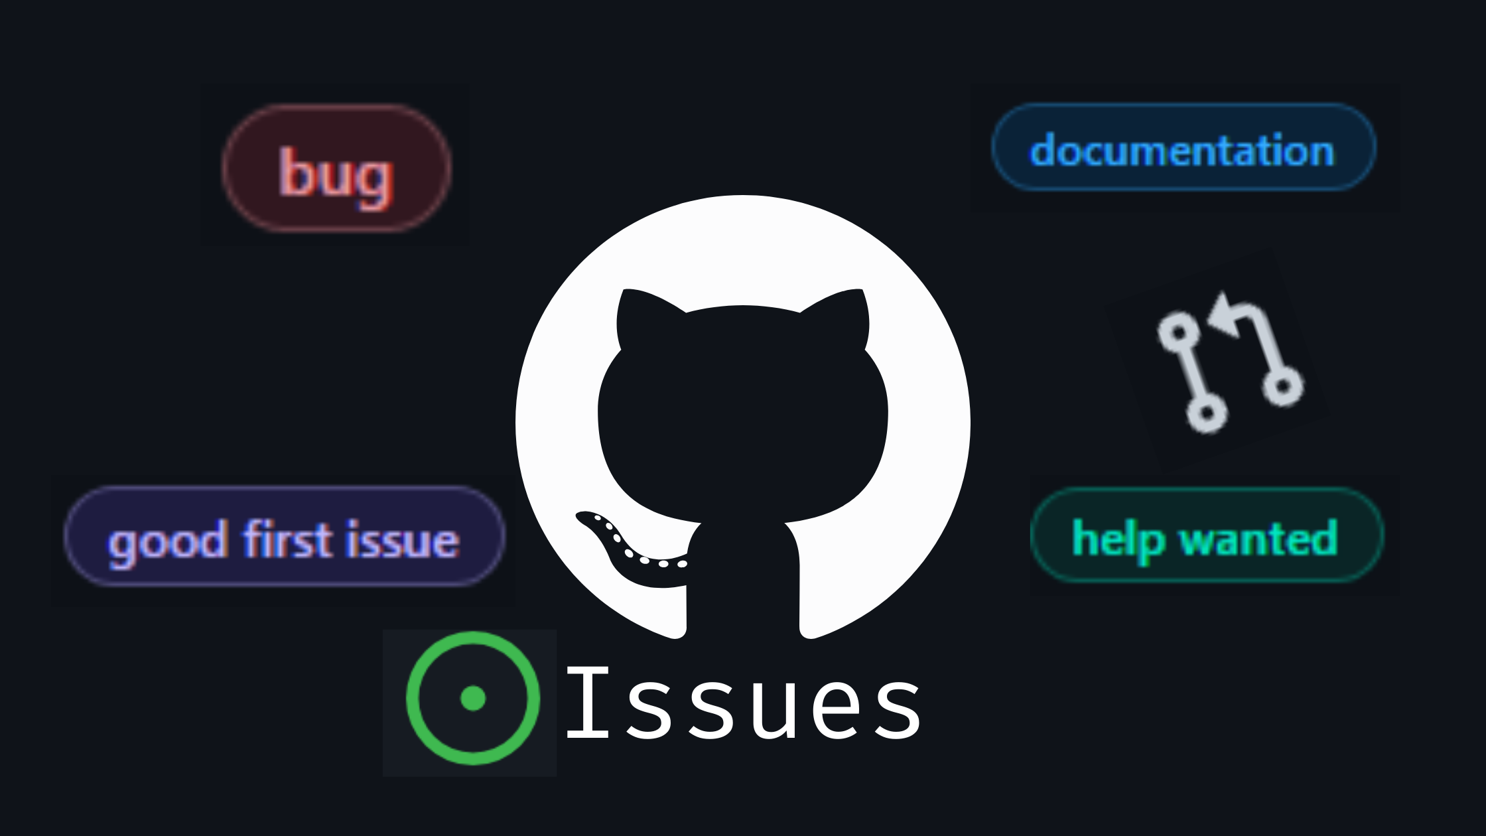
Epic & Issue Organization

Slide 6
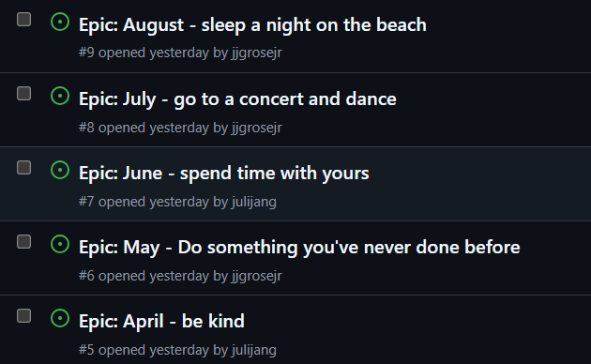
Declaring our Epics and User Stories
Propose an Epic for each month of the year
Construct a user story (US) pertaining to each month
Keep track of any issues and labels

Slide 7
Task Distribution

Slide 8
Organizing Team Tasks & Goals
Follow the Agile development method
Utilize CI/CD principles when coordinating tasks in relation to the Epic and User Stories
Allocate work according to each section of the project, i.e., each team member will work each epic chronologically, pushing deployments
Work congruently over Discord or in-person while making changes (often when possible), leading to less commits from different contributors introducing conflicts

Slide 9

Pipeline Framework

Slide 10
Pipeline Framework
We focused our pipeline construction around each month of the year.
Pipeline monthly goals were all possible tasks or goals from January through December
Each month had a unique set of tasks defined by the User Stories

Slide 11
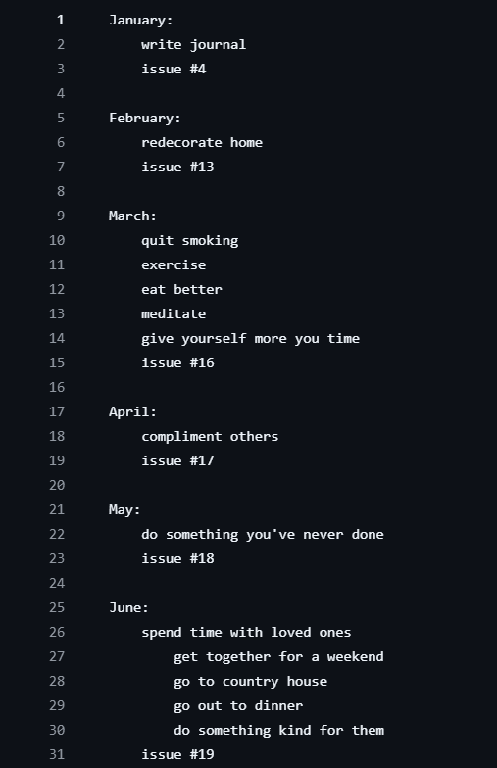
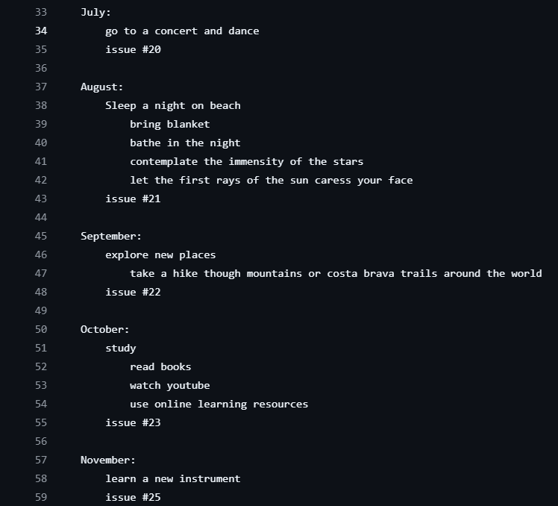
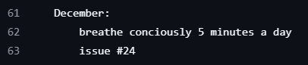
Pipeline Outline (TASKSPERMONTH.txt)

Slide 12


Program Development

Slide 13
Programming the Pipeline
Development for the pipeline was done in Groovy just as previous pipelines in this course were developed.
We ran into some small issues coordinating months with each user story, however these were eventually resolved, allowing each month to return its own unique set of user stories

Slide 14
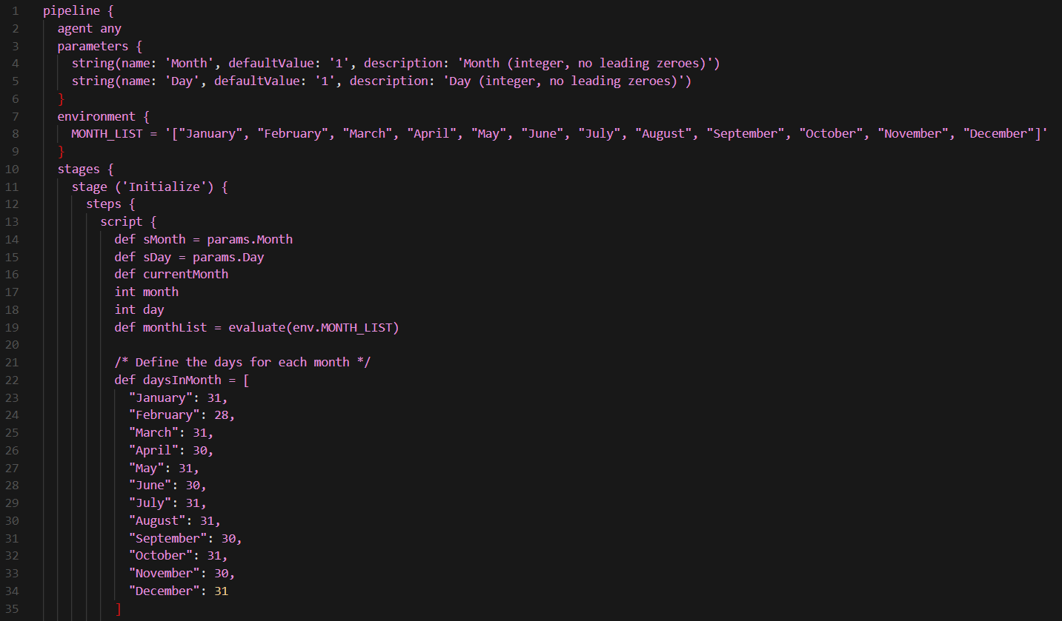
Pipeline Code Snapshots

Slide 15
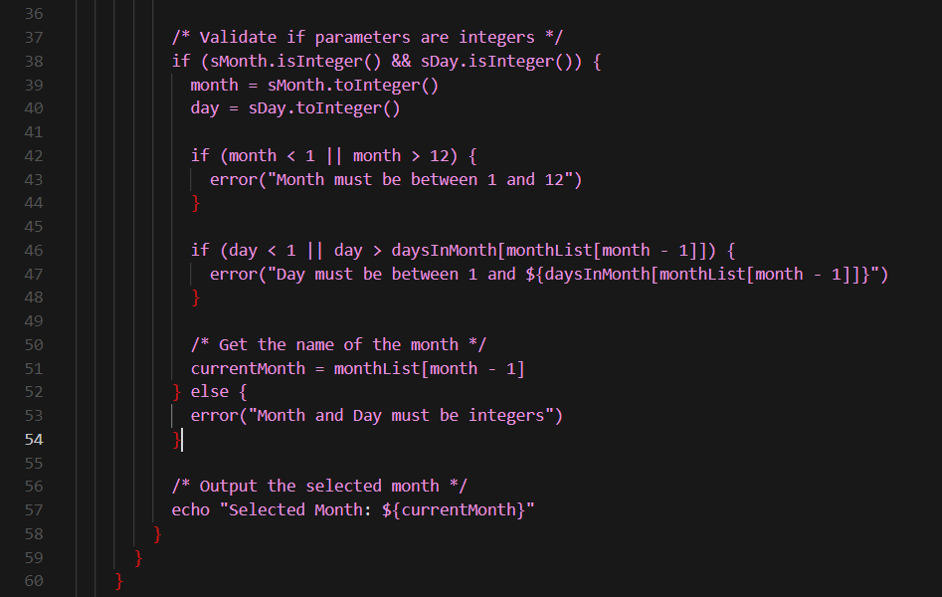
Pipeline Code Snapshots

Slide 16
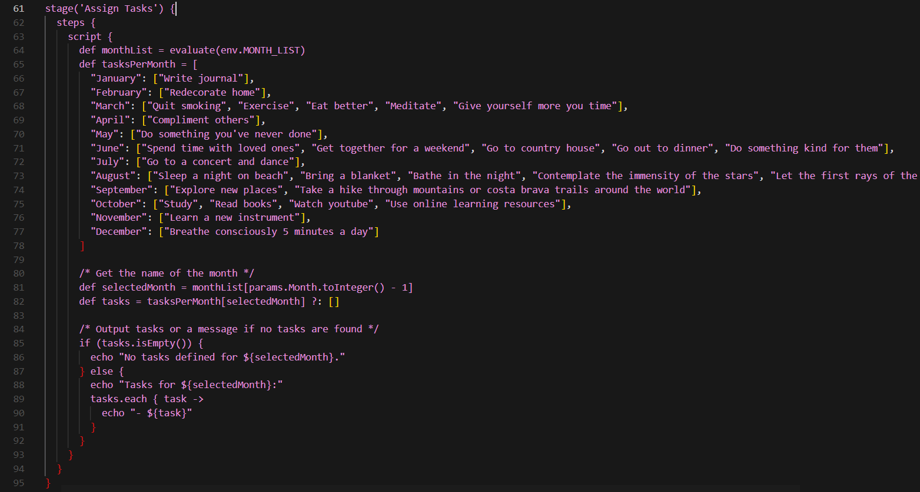
Pipeline Code Snapshots

Slide 17
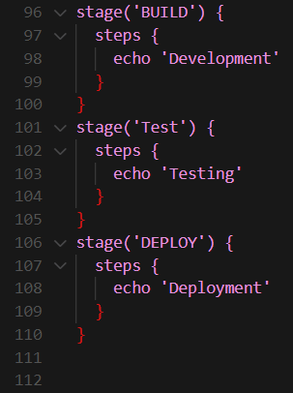
Pipeline Code Snapshots

Slide 18
Deployment

Slide 19
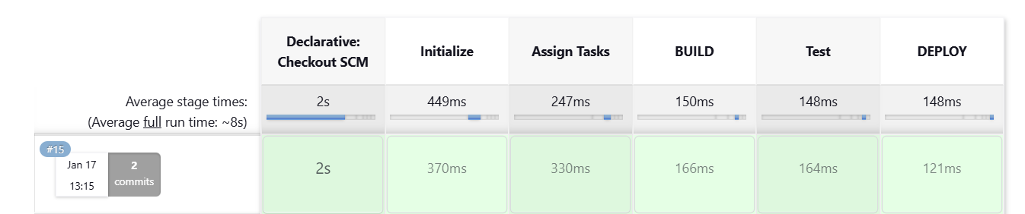
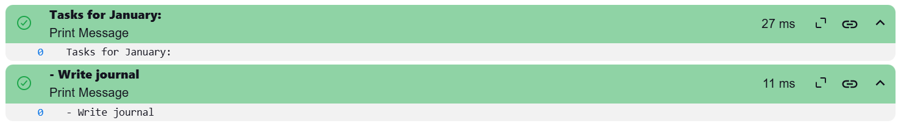
Pipeline Deployment
The pipeline was deployed to Jenkins through the project GitHub repository, successfully returning outputs (User Stories) corresponding to the month (Epic).

Slide 20
Project Outcome

Slide 21

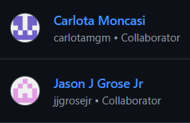
Accomplishments Using DevOps
This project effectively conveyed our use of CI/CD to build, test, and deploy a DevOps pipeline effectively using all of the following:
GitHub for repository
Visual Studio Code for code editing
Groovy pipeline script language to develop the pipeline application
Jenkins for Build, Test, Deploy pipeline structure

